Slide 1
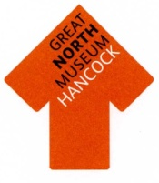
Legacy

Slide 2
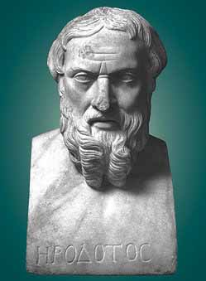
History

Slide 4
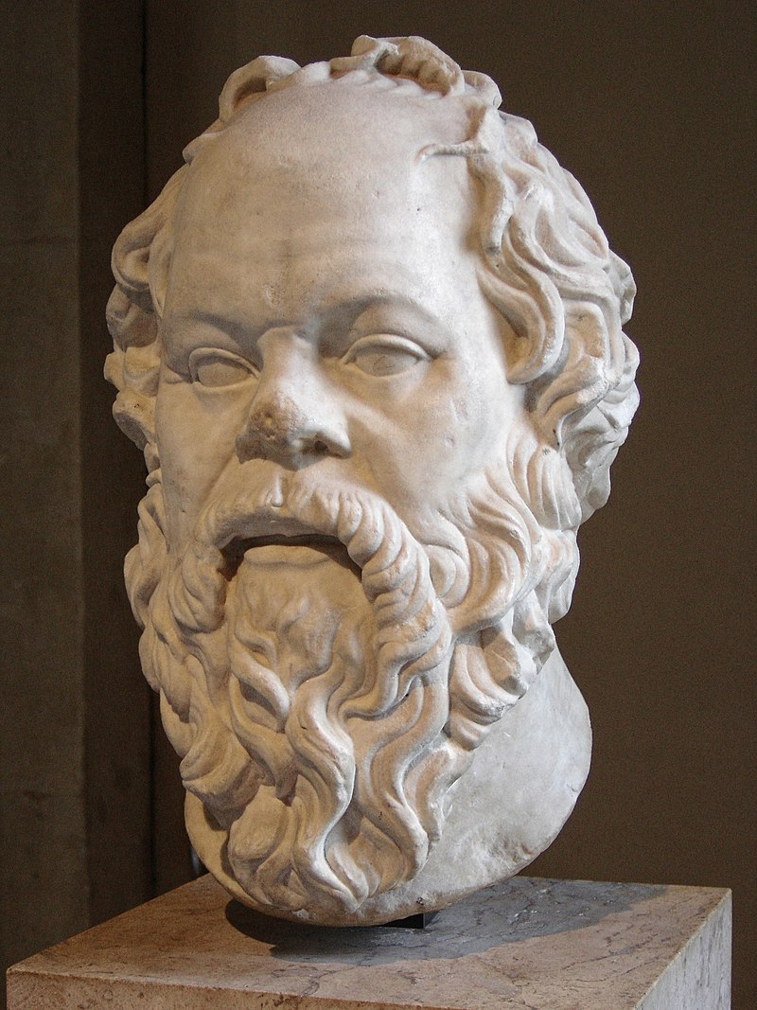
Philosophy

Slide 5
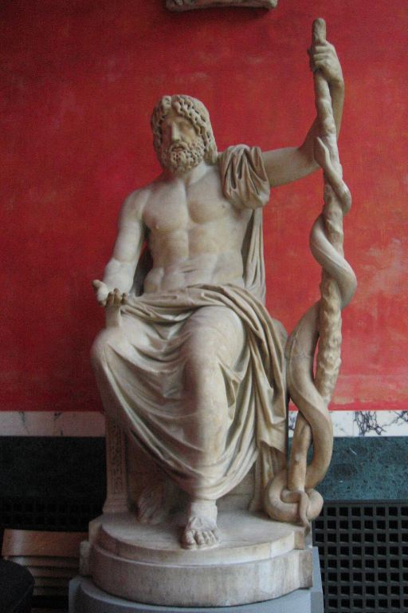
Medicine

Slide 6
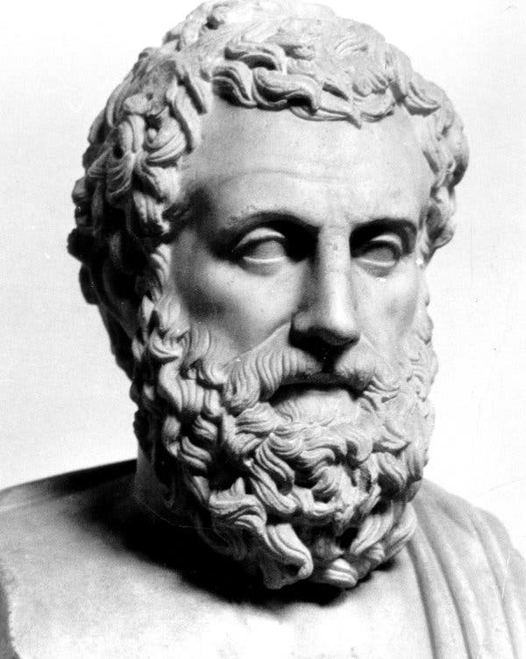
Science

Slide 7
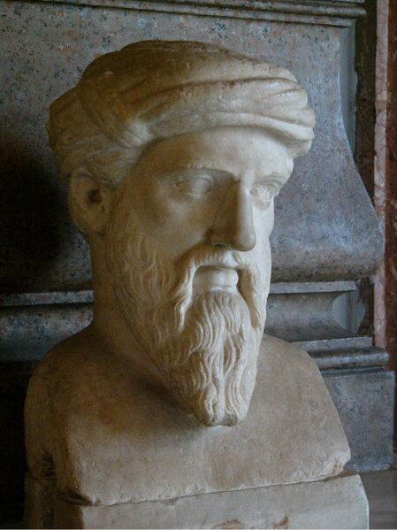
Maths

Slide 8
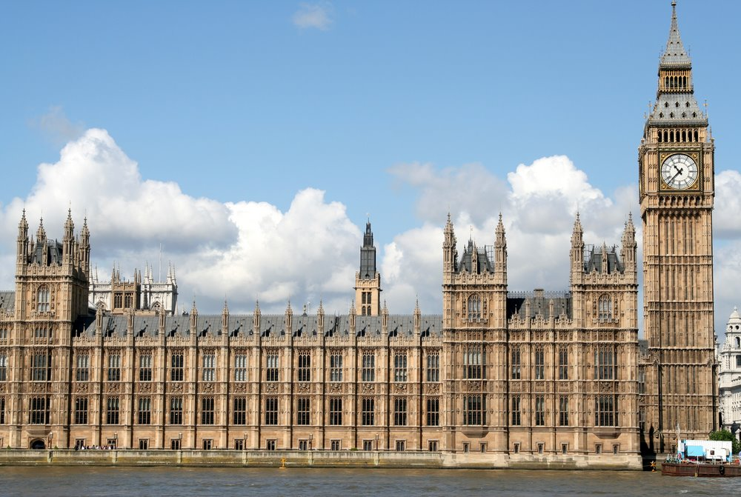
Politics

Slide 9
Olympic Games

Slide 10
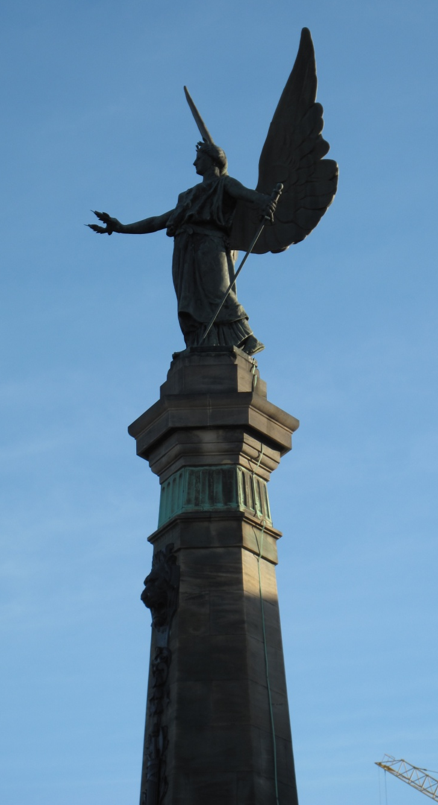
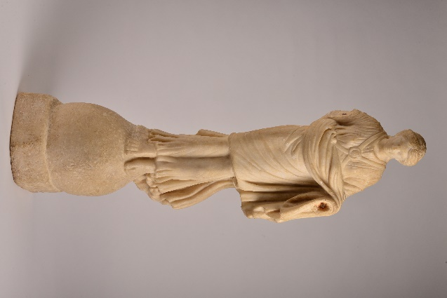

Slide 11
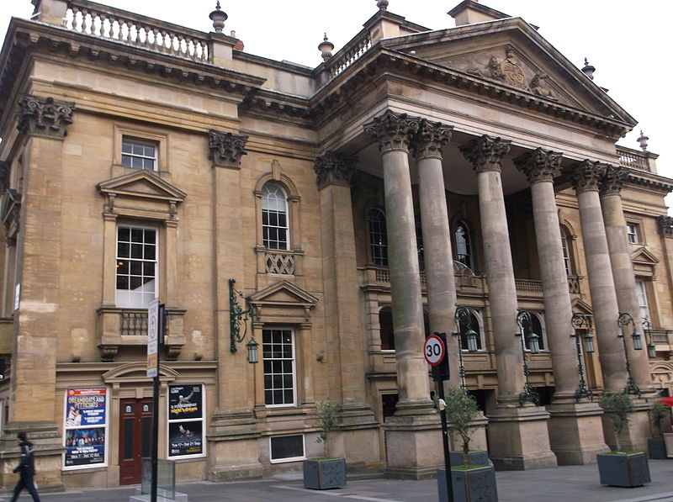
Theatre

Slide 12
Architecture
Notes:
Many of Newcastle’s buildings use architectural elements taken from Greek temples. Buildings in a Classical style were popular in the 18th and 19th centuries and many were influenced by descriptions of the buildings travellers encountered in Greece. The three examples here are:
1. The Moot Hall.
2. The Theatre Royal.
3. The Literary and Philosophical Society.

Slide 13
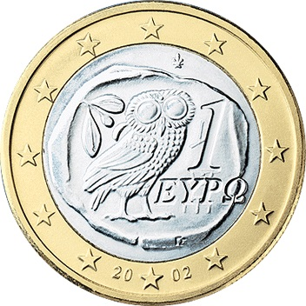
Coinage

Slide 14
Toys

Slide 15
(Super)Heroes

